Slide 1
From Vector Space Model to BM25
ChengXiang Zhai
UIUC

Slide 2
Text Retrieval Problem

Slide 3
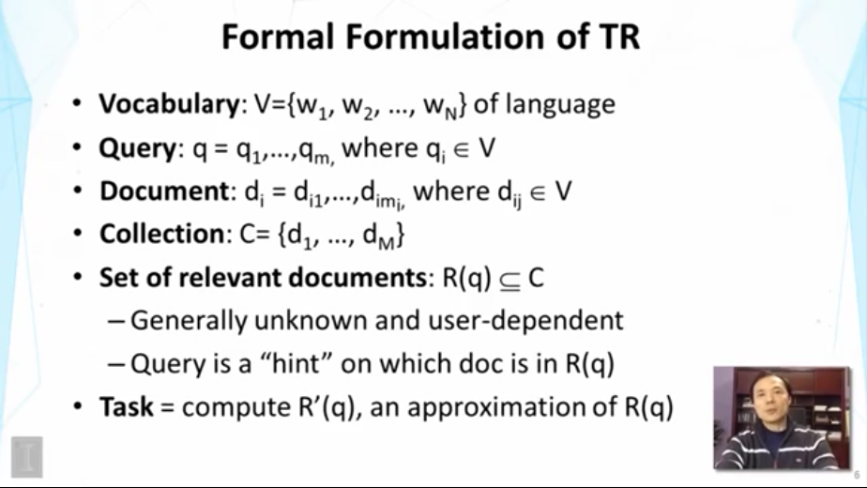

Slide 4
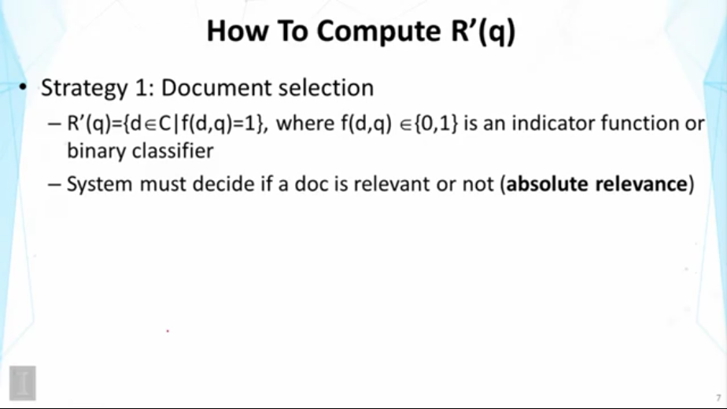

Slide 5
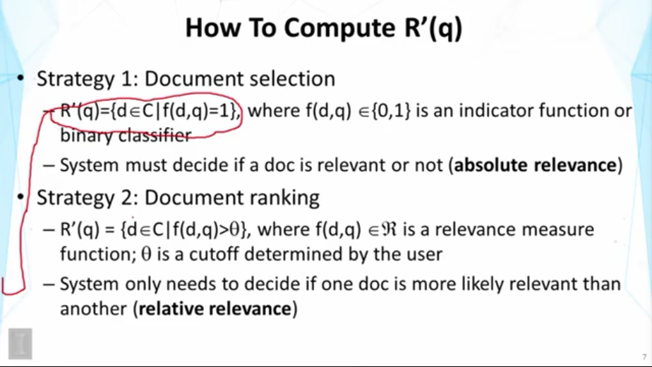

Slide 6
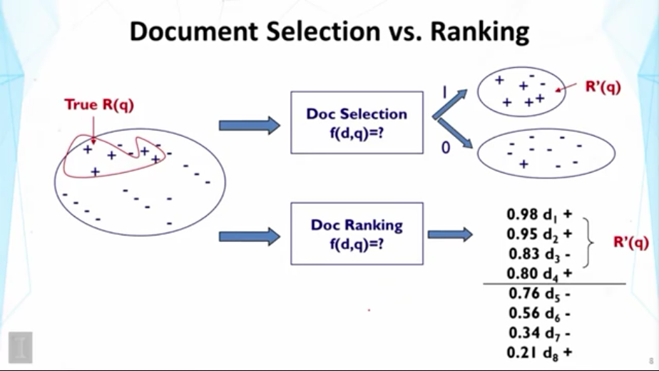

Slide 7
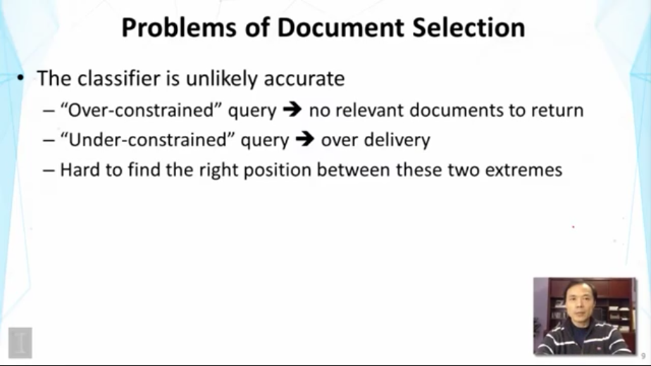

Slide 8
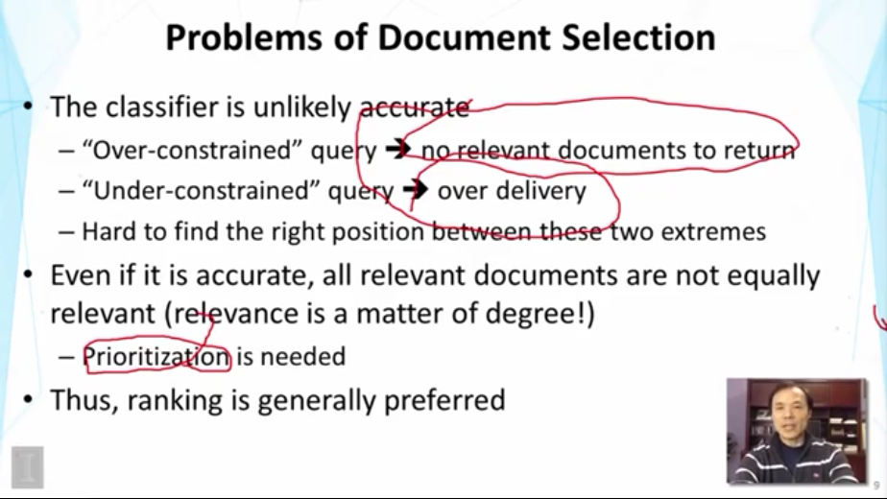

Slide 9
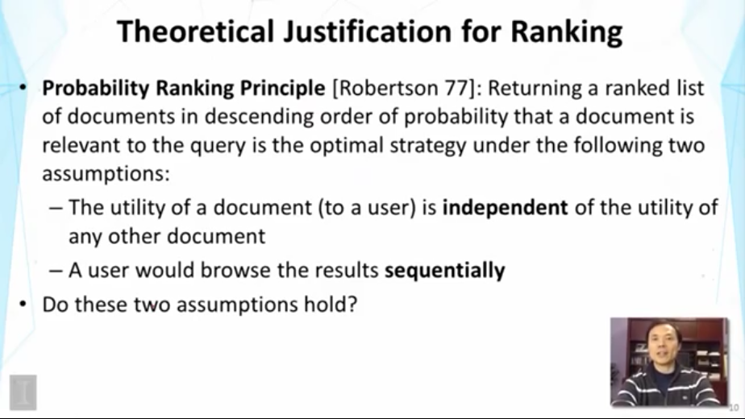

Slide 10
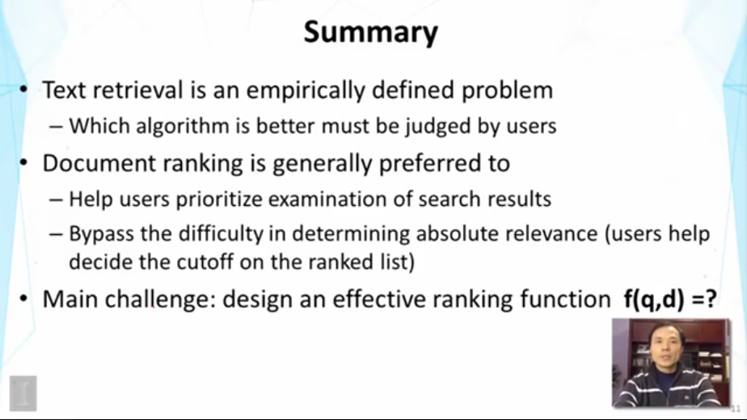

Slide 11
Text Retrieval Methods

Slide 12
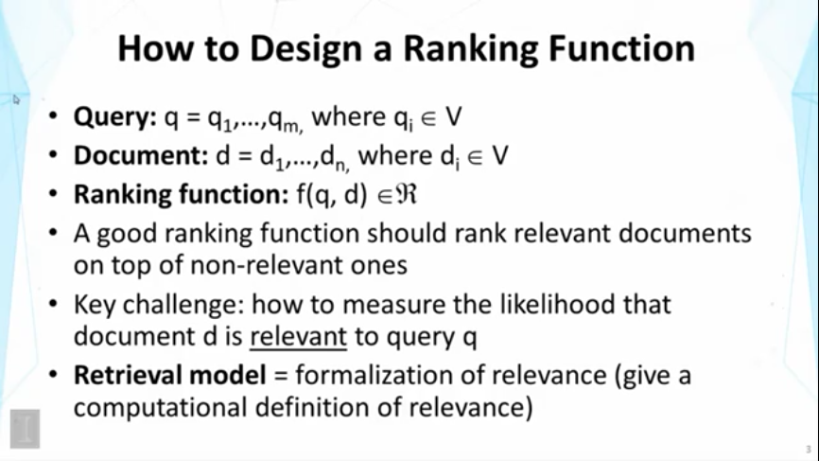

Slide 13
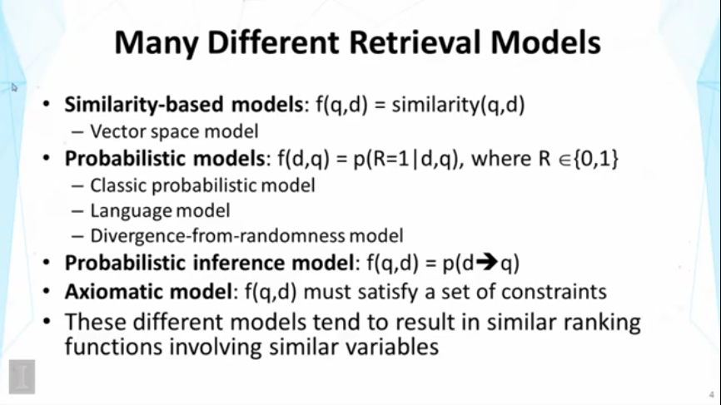
Notes:
axiomatic英 [ˌæksiəˈmætɪk] 美 [ˌæksiəˈmætɪk] adj.<正>公理的;不证自明的;原则的;格言的

Slide 14
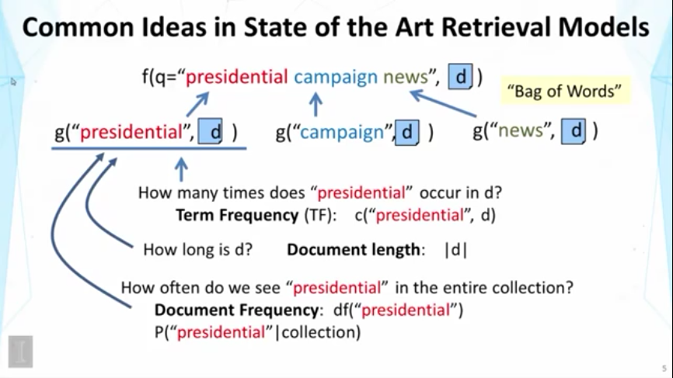

Slide 15
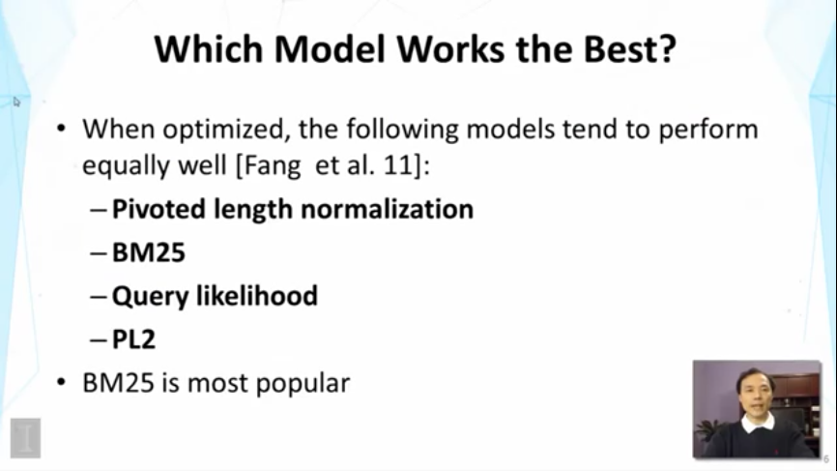
Notes:
pivoted英 ['pɪvətɪd] 美 ['pɪvətɪd] adj.转动的，回转的，装在枢轴上的

Slide 16
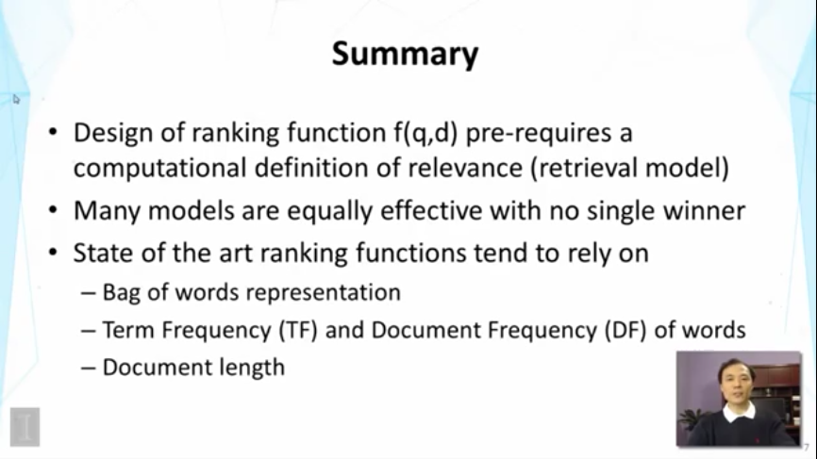

Slide 17
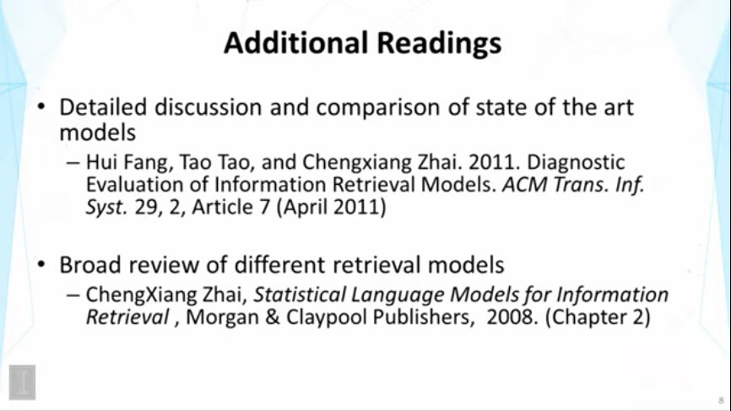

Slide 18
Vector Space Model Improved Instantiation

Slide 19
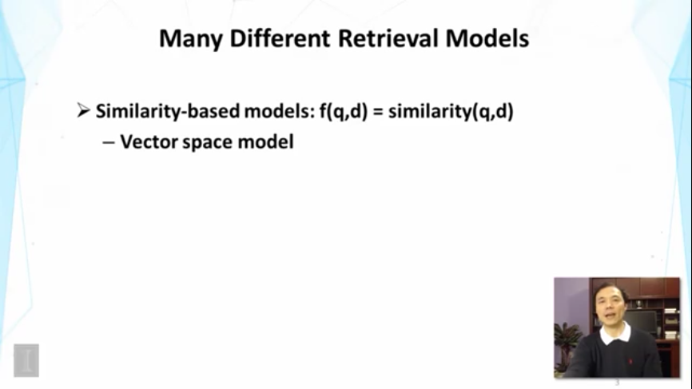

Slide 20
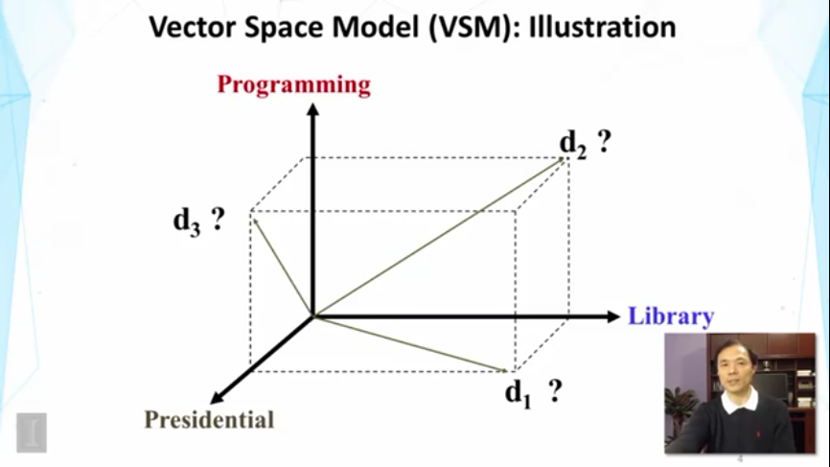

Slide 21
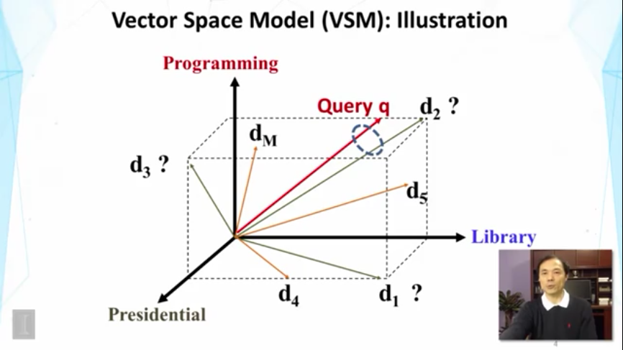

Slide 22
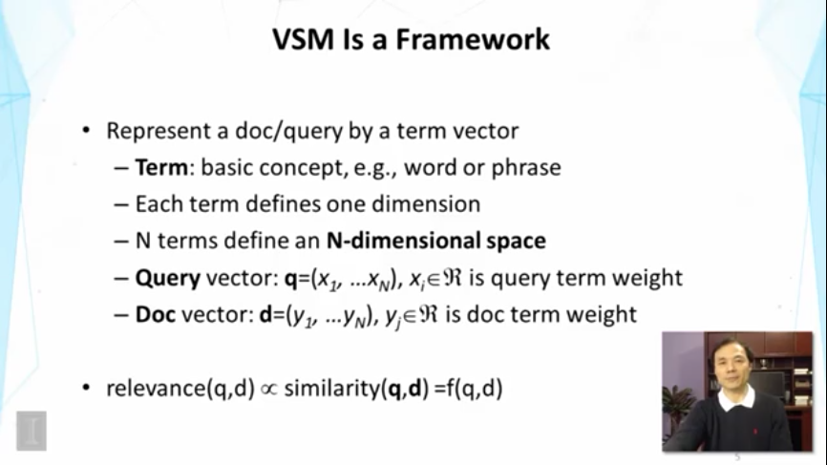

Slide 23
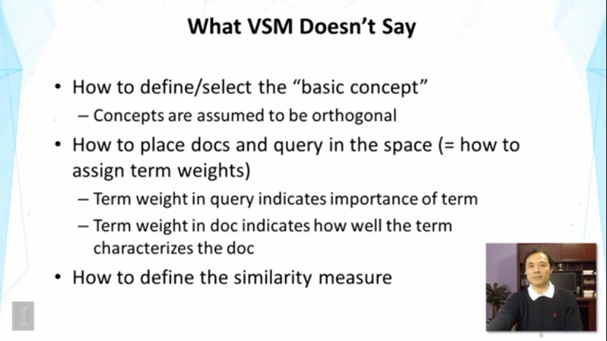

Slide 24
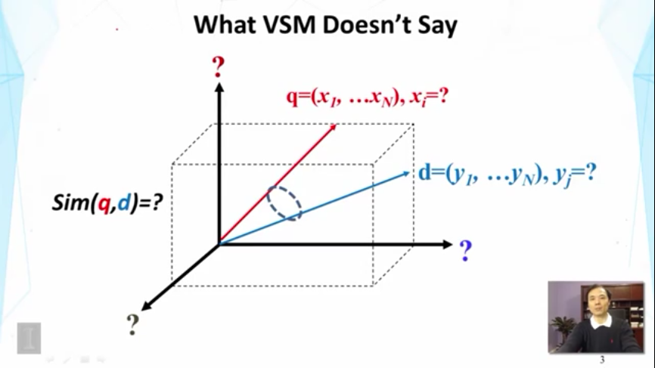

Slide 25
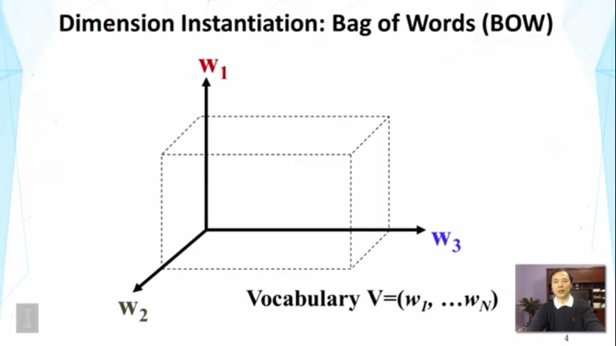

Slide 26
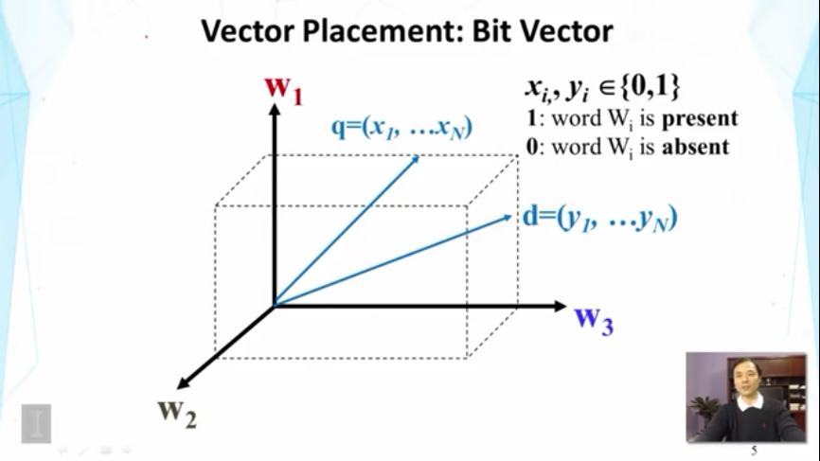

Slide 27
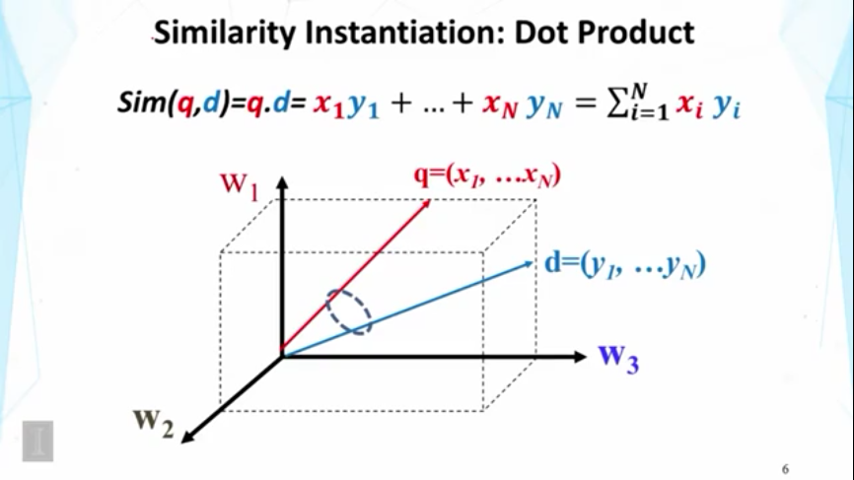

Slide 28
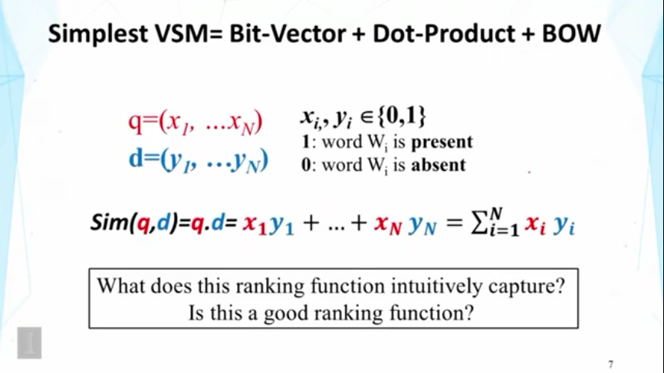

Slide 29
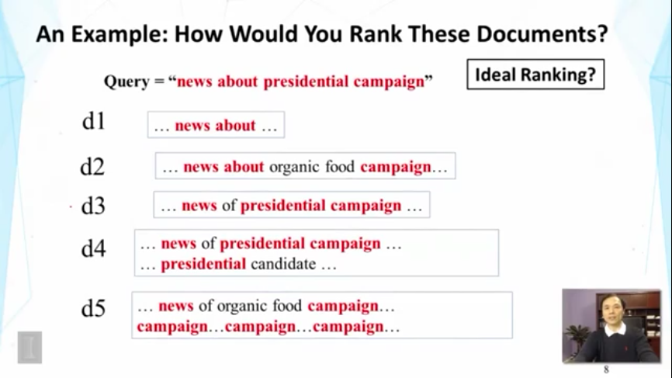

Slide 30
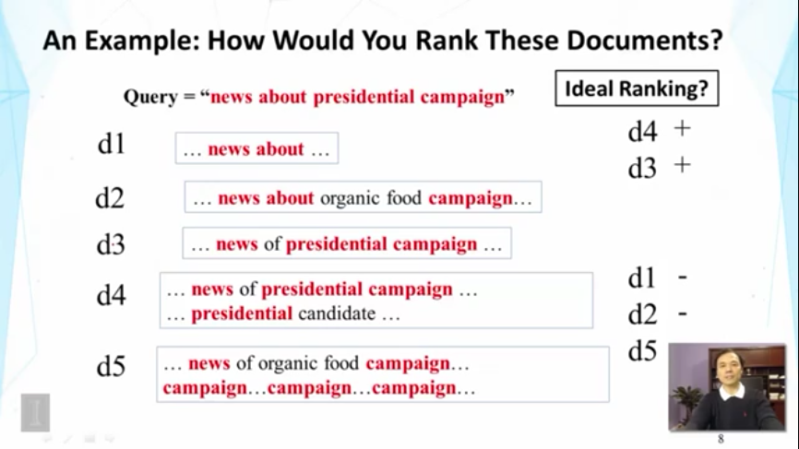

Slide 31
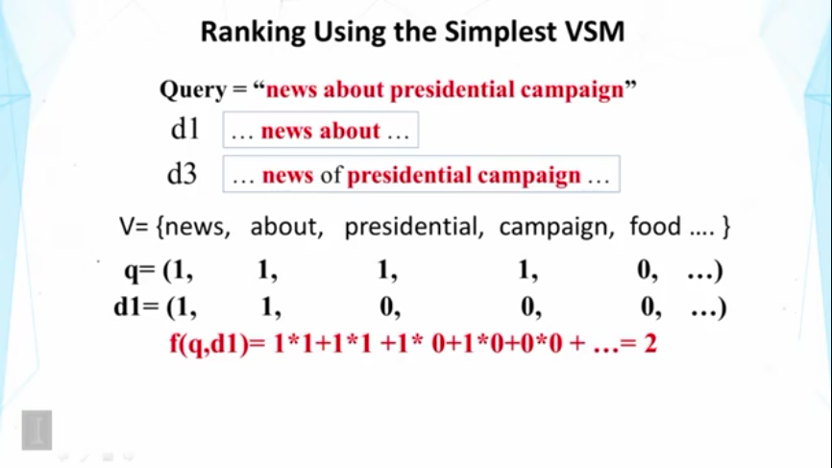

Slide 32
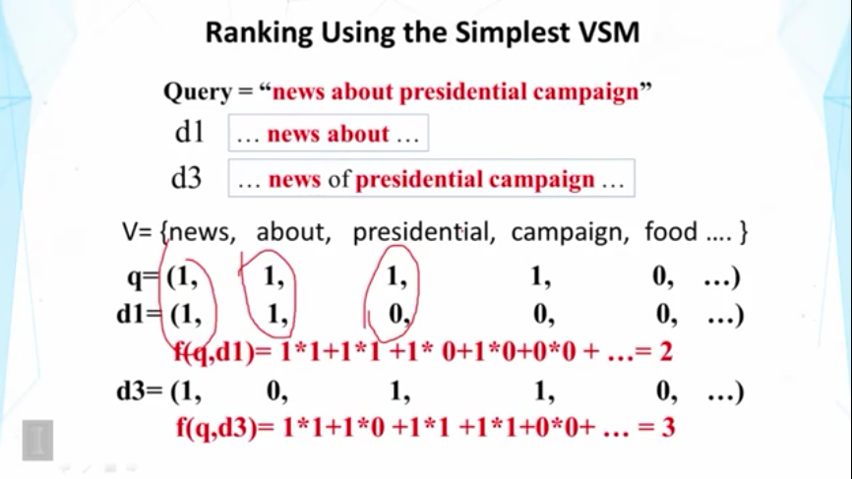

Slide 33
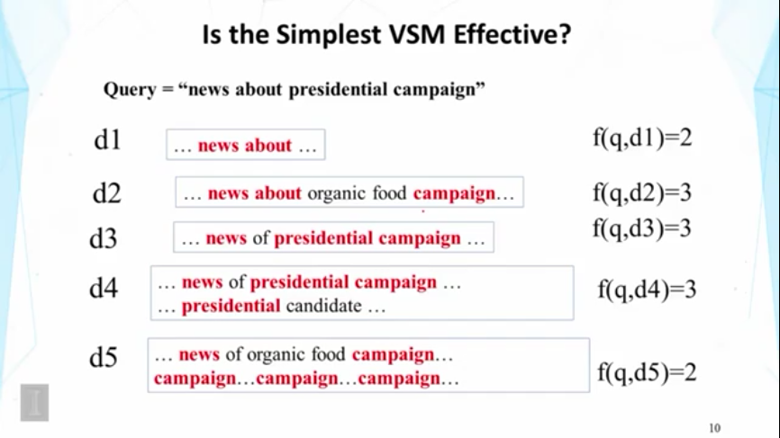

Slide 34
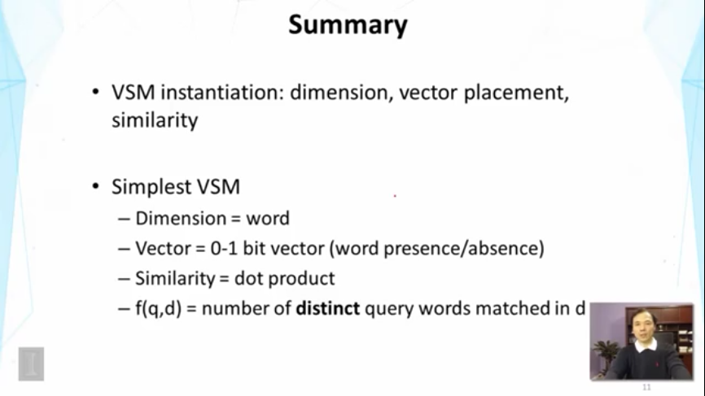

Slide 35
TF Transformation

Slide 36
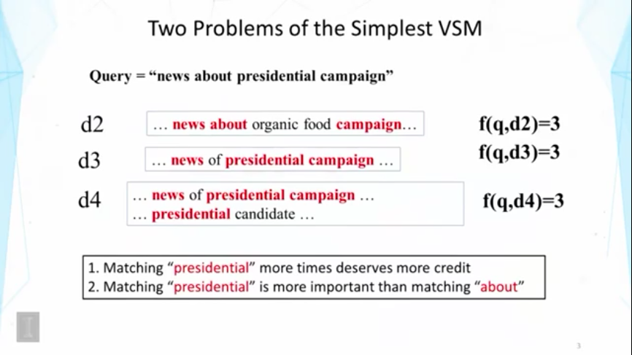

Slide 37
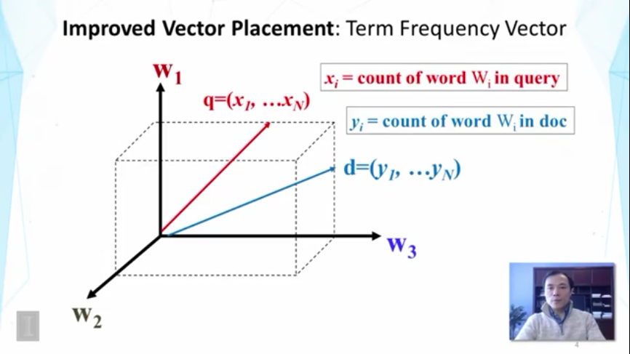

Slide 38
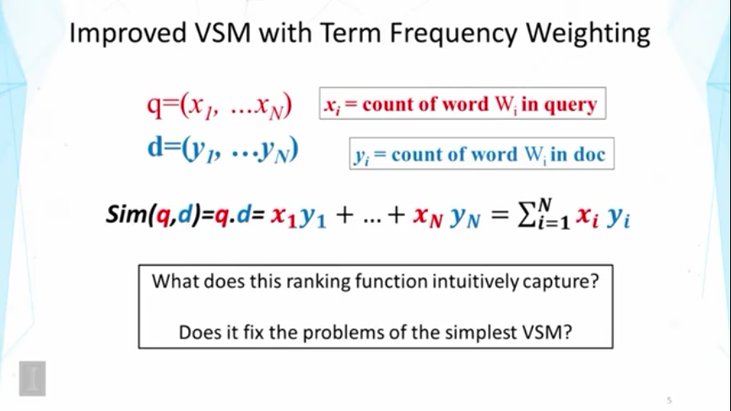

Slide 39
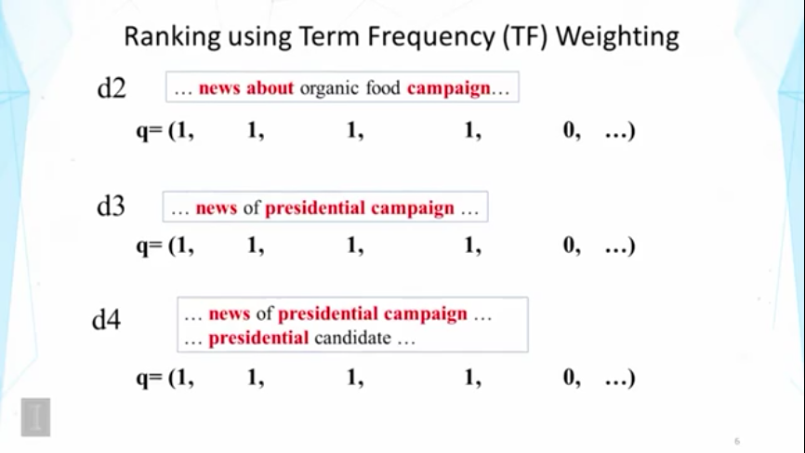

Slide 40
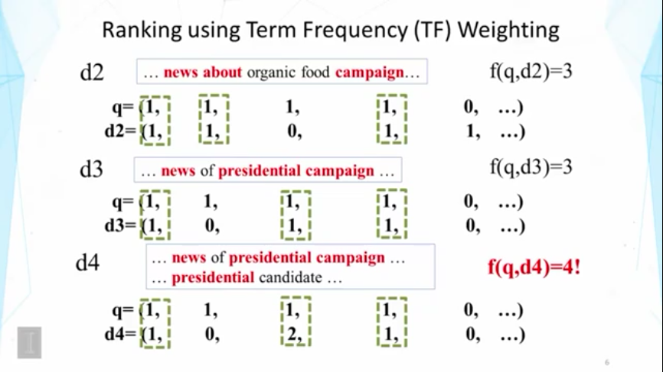

Slide 41
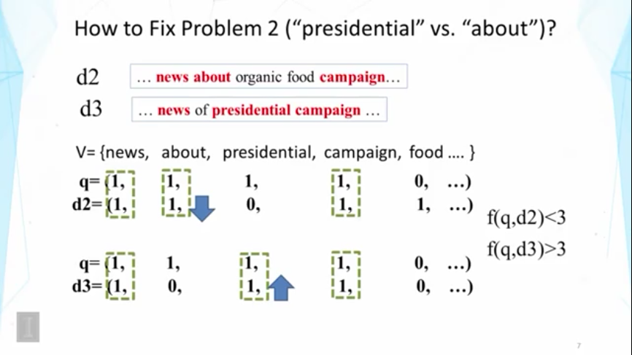

Slide 42
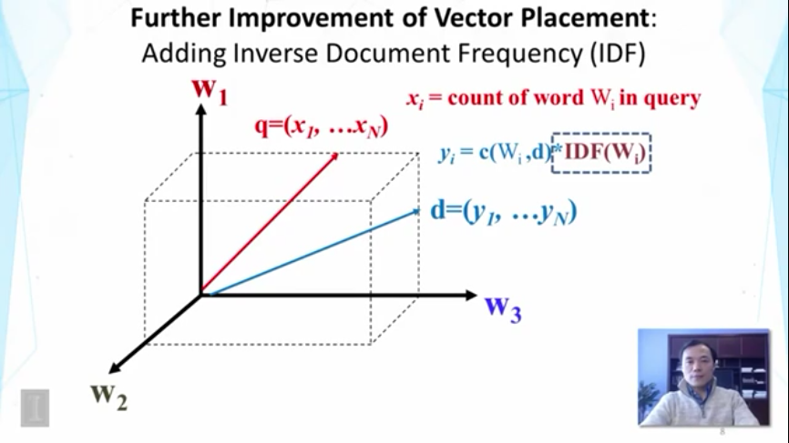

Slide 43
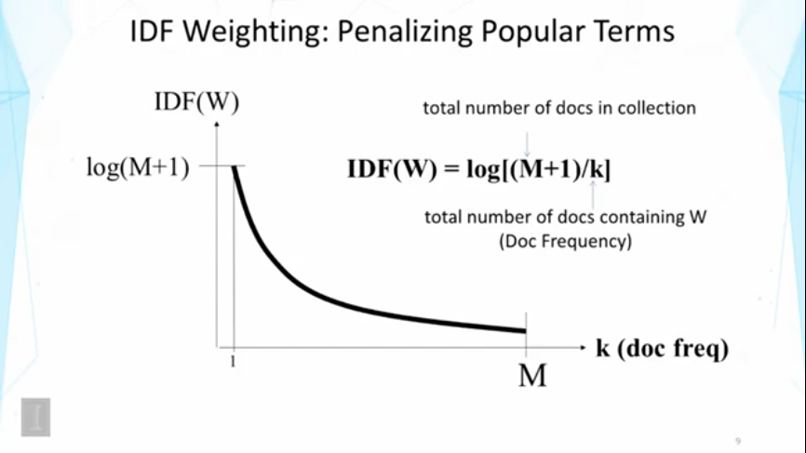

Slide 44
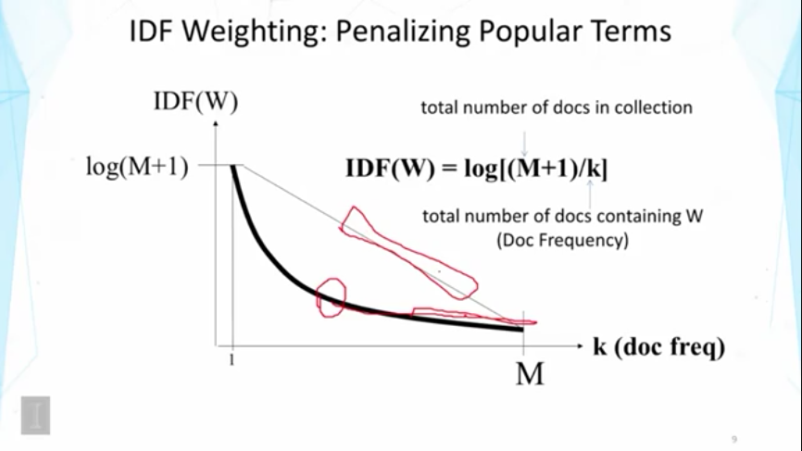

Slide 45
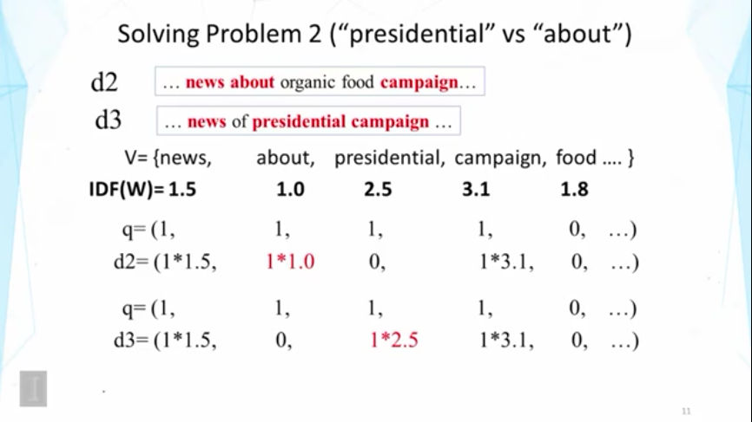

Slide 46
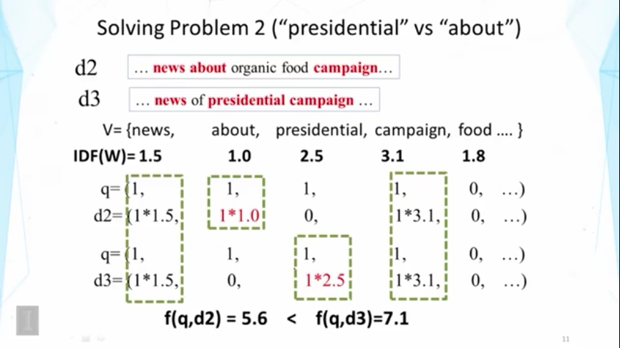

Slide 47
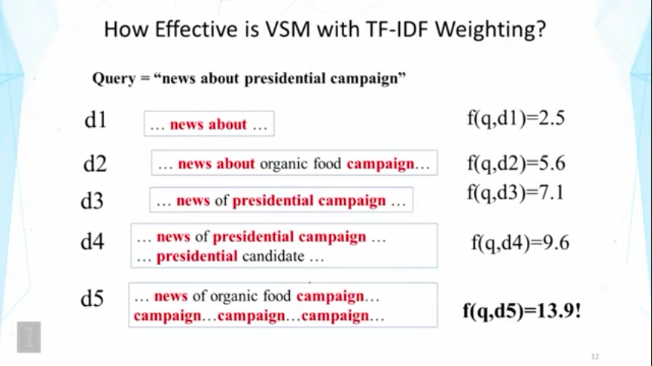

Slide 48
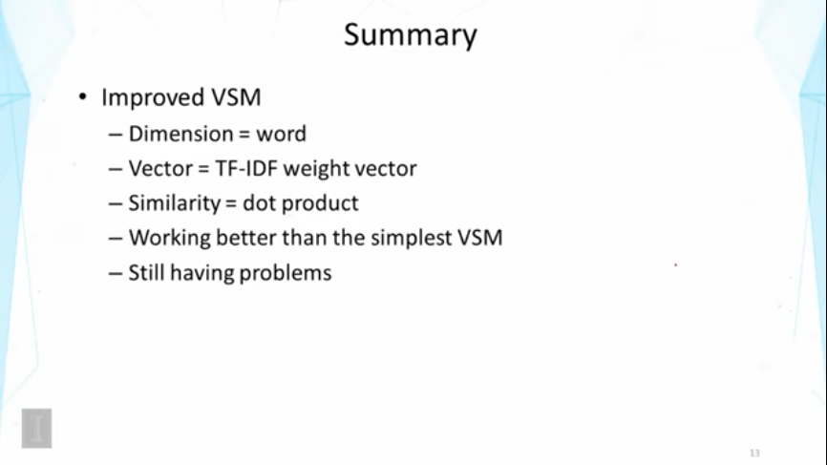

Slide 49
TF Transformation

Slide 50
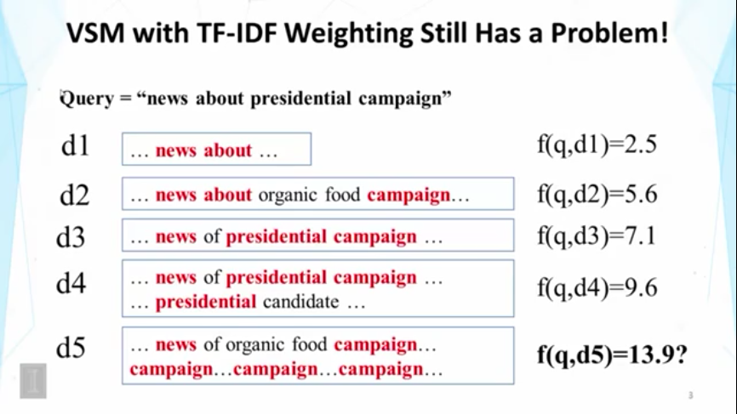

Slide 51
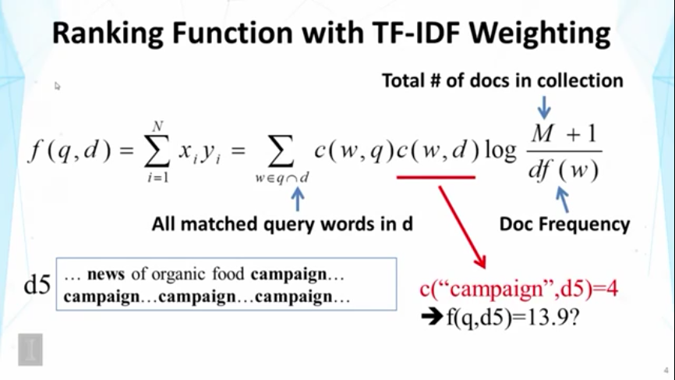

Slide 52
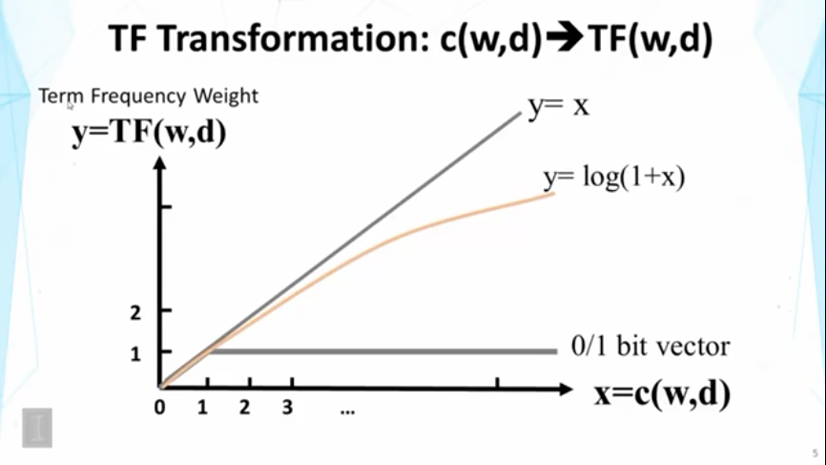

Slide 53
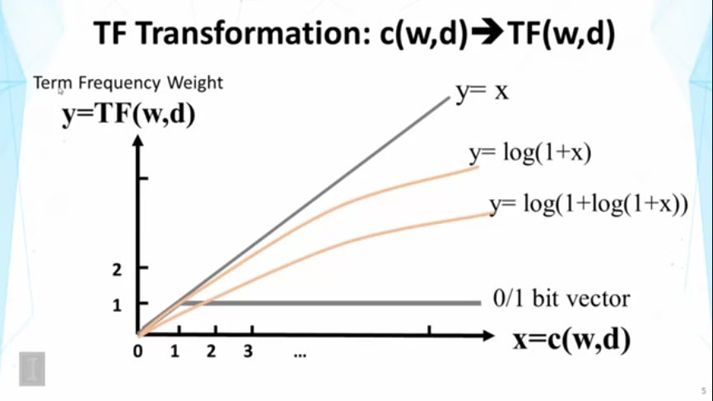

Slide 54
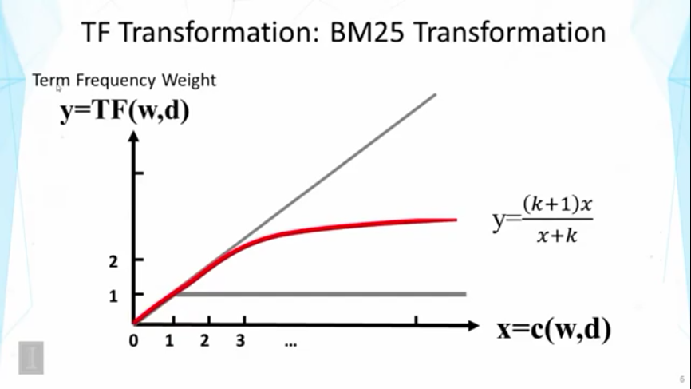

Slide 55
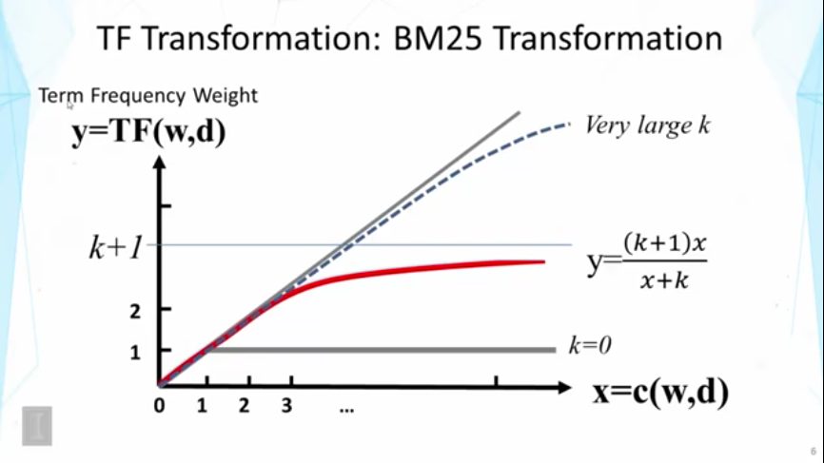

Slide 56
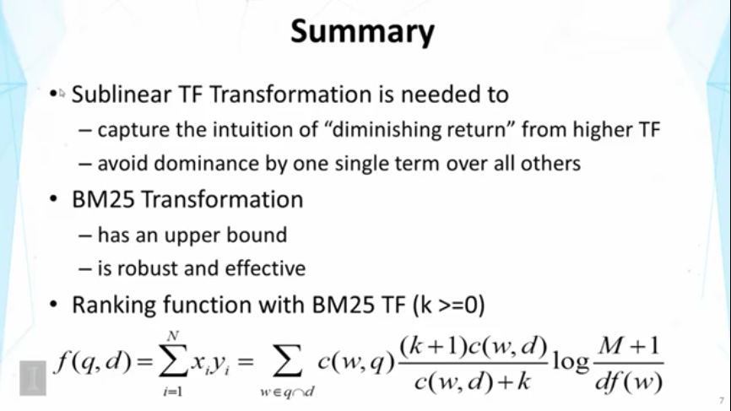

Slide 57
Doc Length Normalization

Slide 58


Slide 59


Slide 60


Slide 61


Slide 62


Slide 63


Slide 64


Slide 65


Slide 66


Slide 67
System Implementation

Slide 68


Slide 69


Slide 70


Slide 71


Slide 72


Slide 73


Slide 74

Homework4: Pivoted Length Normalization VSM and BM25
Deadline: 2018.12.1, 23:00
https://trec.nist.gov/data/microblog.html

Slide 75

Homework4: Pivoted Length Normalization VSM and BM25
Deadline: 2018.12.1, 23:00
30548条tweets，用于创建inverted index

Slide 76

Homework4: Pivoted Length Normalization VSM and BM25
Deadline: 2018.12.1, 23:00
https://trec.nist.gov/data/microblog2014.html

Slide 77


Homework4: Pivoted Length Normalization VSM and BM25
Deadline: 2018.12.1, 23:00
TREC 2014 topics with added "Description" field
Query: Ron Weasley birthday
55个queries，用于测试Boolean Retrieval Model

Slide 78
Homework4: Pivoted Length Normalization VSM and BM25
Deadline: 2018.12.1, 23:00
任务：
实现Pivoted Length Normalization VSM;
实现BM25；
注意
改进Postings：(docID, Freq)，不仅记录单词所在的文档ID，也记录其在文档中的Frequency；
构建inverted index时，记录文档的长度，以及计算average document length (avdl)

